Slide 1


📡
Building a
What's Inside
Telecom Solution
Architect Co‑Pilot
01 Problem Statement
02 What is RAG?
03 RAG Pipeline
04 Solution Overview
05 Tech Stack
06 System Architecture
AI-powered assistant for telecom architecture and TM Forum standards
07 Web + PDF Ingestion
Built using RAG + cloud LLM deployment architecture
08 Auto-Scheduler
Pinecone + RAG
LM
09 UI Demo
10 Key Features
11 Challenges
Shruti Jain
B.Tech Computer Science
AI Telecom - Intern
12 Solutions
13 Future Work
14 Conclusion

Slide 2
SLIDE 02 — THE CHALLENGE
Problem Statement
📚
⏱️
🤖
Fragmented Knowledge
Time-Consuming Search
No Intelligent System
Telecom knowledge (eTOM, SID, TMF APIs) is spread across hundreds of PDF documents and scattered web sources with no central access point.
Architects spend significant time manually searching for relevant information across multiple specifications and frameworks.
No existing system provides context-aware, structured answers aligned with telecom architecture frameworks and standards.
Need: A system that provides fast, structured, and architecture-aligned telecom insights.

Slide 3
SLIDE 03 — CORE CONCEPT
What is RAG? (Retrieval-Augmented Generation)
R
A
G
Retrieval
R
Combines information retrieval + language generation. Searches through telecom documents and web content using vector embeddings to find relevant context.
Augmented
A
Retrieves relevant document content before answering. The retrieved chunks are injected as context alongside the question before it goes to the LLM.
Generation
G
Uses retrieved context instead of relying only on model knowledge — ensuring responses are accurate, grounded, and domain-specific.
Key Benefit: Ensures responses are accurate, grounded, and domain-specific — not hallucinated from model weights.

Slide 4
SLIDE 04 — HOW IT WORKS
RAG Pipeline — Step by Step
📄
✂️
🧠
🗃️
🔍
⚡
01
›
02
›
03
›
04
›
05
›
06
Document
Ingestion
Chunking
Embedding
Generation
Vector DB
Storage
Retrieval
Generation
Load data from multiple sources
Break content into smaller pieces
Convert text into vector format
Store data for fast search
Fetch relevant information
Generate structured response

Slide 5
SLIDE 05 — SOLUTION OVERVIEW
Solution Overview
🌐 Cloud-Deployed RAG System — PDFs + Web Sources
📄
🗃️
⚡
Dual Ingestion
Pinecone Vector DB
Groq LLM
Loads PDFs from 5 telecom domain folders AND scrapes live TM Forum + ServiceNow web pages.
All content — PDF and web — is chunked, embedded, and stored in a single cloud vector index.
llama-3.3-70b-instant via Groq API generates fast, structured, architecture-aware answers.
Always fresh
Cloud scalable
Fast inference
Outcome: Accurate, document-grounded answers combining static PDFs with live web knowledge — accessible anywhere.

Slide 6
SLIDE 06 — TECHNOLOGY
Technology Stack
⚙️ Core Stack
✅ Key Features
🗃️
Vector DB
Pinecone (cloud)
Uses PDFs + scraped URLs as knowledge base
🧠
Embeddings
HuggingFace MiniLM-L6-v2
Ensures accurate, grounded answers
⚡
LLM
Groq (llama-3.3-70b-instant)
Combines local docs with live web sources
🌐
Sources
PDFs + Web URLs
Supports deep telecom architecture queries
🖥️
UI
Streamlit
🐍
Language
Python 3.11

Slide 7
SLIDE 07 — SYSTEM ARCHITECTURE
End-to-End Architecture
Key
Capability
💬
User Query → Streamlit UI
↓
• Answers from retrieved PDF + web content only
🔍
Retriever (Pinecone)
• Reduces hallucination significantly
↓
📄
Relevant PDF + Web Chunks
• Fast Groq inference, low latency
↓
⚡
Groq LLM (llama-3.3-70b-instant)
• Cloud-scalable via Pinecone
↓
✅
Final Structured Answer

Slide 8
SLIDE 08 — DYNAMIC KNOWLEDGE BASE
Ingest: PDFs + Web Scraping
🌐 Web Scraping (ingest.py)
📁 5 Domain Folders
Sources added:
ETOM — Business process framework
TM Forum Open APIs page
SID — Information data model
TM Forum GitHub repositories
TMF_APIs — TM Forum Open APIs
ServiceNow Telecom docs
ServiceNow Network Inventory
Architecture — System design blueprints
How it works:
ServiceNow — ITOM, CSM, network inventory
requests + BeautifulSoup scrape each URL → stripped to plain text (20KB) → merged with PDF docs → chunked + embedded into Pinecone

Slide 9
SLIDE 09 — AUTOMATION
24-Hour Auto-Scheduler
⏰ scheduler.py
✅ Key Benefits
import time
from ingest import run_ingestion
while True:
try:
run_ingestion()
print('✅ Done')
except Exception as e:
print(f'❌ {e}')
time.sleep(86400) # 24h
Runs ingestion every 24 hours automatically
Always-fresh combined web + PDF knowledge base
Re-scrapes TM Forum & ServiceNow pages daily
Error handling with fallback logging
No manual re-ingestion required

Slide 10
SLIDE 10 —OPTIONAL
Local Setup (Optional)
Steps
Configuration
Required API Keys:
GROQ_API_KEY
PINECONE_API_KEY
Clone the repository
Install dependencies
pip install -r requirements.txt
Run ingestion (to build knowledge base)
python ingest.py
Set via:
.env (local)
Streamlit secrets (recommended)
Start the application
streamlit run chatbot.py
Note: The application is already deployed. Local setup is optional.

Slide 11
SLIDE 11 — CAPABILITIES
Key Features
🏷️
📋
🏗️
Domain-Aware Answers
Structured Output
Architecture Reasoning
Auto-detects question domain (eTOM, SID, TMF APIs, Architecture) and routes to the right knowledge context.
Every response: Definition → Telecom Context → Architecture Relevance → Example → Related APIs.
Generates OSS/BSS architecture designs with components, flow, TMF API mapping, and integration points.
📄
🕐
💬
Dual-Source Tagging
Timestamp Tracking
Chat History
Each answer references the exact PDF document or source URL plus the domain framework that backed it.
Every message timestamped (IST) for full conversation auditability and session history.
Multi-session named chats with delete, active highlight, and full conversation history sidebar.

Slide 12
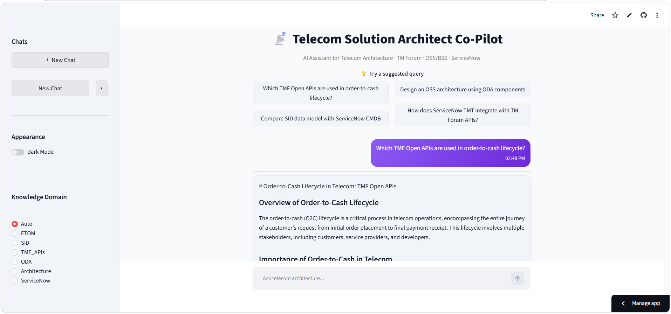
SLIDE 12 — UI DEMO
Application UI
Live Application link: telecom-solution-architect-4cquhhnqfdujgxakdwjqbd.streamlit.app

Slide 13
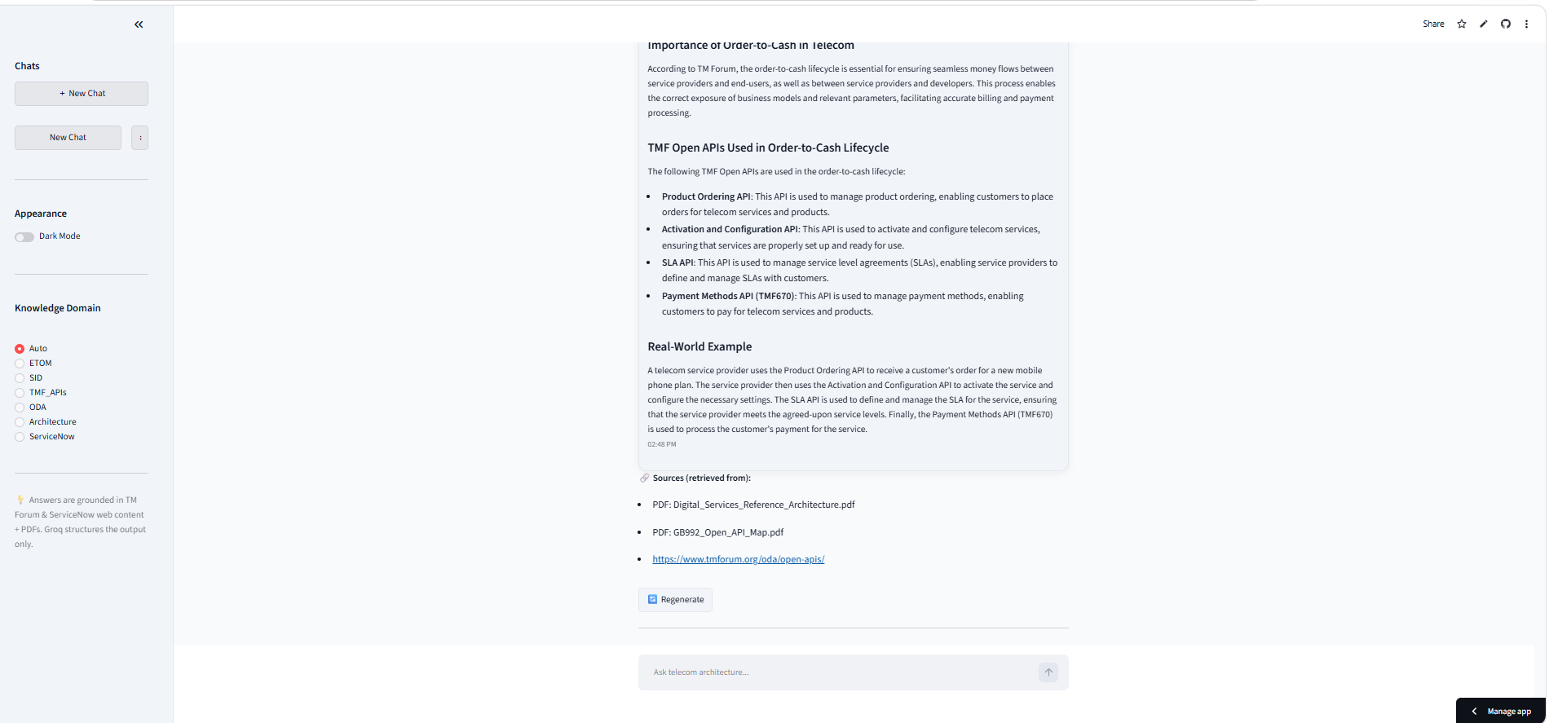
SLIDE 13 — UI DEMO
Application UI
streamlit.app — Telecom Co-Pilot
What You See
📸
Structured responses (Definition → Context → Example)
Answers grounded in retrieved PDFs + URLs
Shows which PDF or URL backed the answer
Chat history across sessions
Screenshot Placeholder
Add app screenshot here
Dark mode toggle
Regenerate answer button

Slide 14
SLIDE 14 —CHALLENGES AND SOLUTIONS
Challenges and Solutions
⚙️ Challenges
✅ Solutions
Large PDF Datasets:
Handling large telecom documents caused memory and ingestion performance issues
Used Pinecone cloud to enable scalable storage and efficient retrieval
Model Compatibility:
LLM output formatting lacked consistency and structured response clarity
Improved response formatting to ensure consistent structured outputs
Optimized deployment configuration and resolved dependency issues
Deployment Errors:
Issues during Streamlit deployment due to dependencies and environment setup
Switched to Groq API for faster inference and stable performance
API Quota Limits:
Initially used Gemini API, but frequent usage limits affected system stability

Slide 15
SLIDE 15 — ROADMAP
Future Enhancements
🏗️
🏢
Architecture Diagram Export
Enterprise Knowledge Sources
Auto-generate architecture diagrams from text using Mermaid.js or draw.io for visual architecture deliverables.
Add support for enterprise document repositories, SharePoint, and proprietary telecom knowledge bases.
🌍
Expanded Web Sources
Add more standards bodies (3GPP, ETSI) and broaden the live web-scraping source list for richer context.

Slide 16
SLIDE 16 — CONCLUSION
Conclusion
🤖
📡
⚡
Unified AI System
Real-World App
Fast & Accurate
Built a single cloud-deployed RAG system combining PDF documents and live web sources via Pinecone + Groq.
Demonstrated real-world telecom AI covering eTOM, SID, TMF APIs, Architecture, and ServiceNow domains.
Groq's high-speed inference combined with Pinecone retrieval delivers grounded answers in seconds.
Key Takeaways
RAG reduces hallucination by grounding answers in real retrieved documents
Combining PDFs with live web scraping keeps the knowledge base current
Groq's fast inference + Pinecone's scalable retrieval enable a responsive cloud app

Slide 17
Thank You!
Shruti Jain
B.Tech Computer Science
Intern – AI / Telecom

